Slide 1





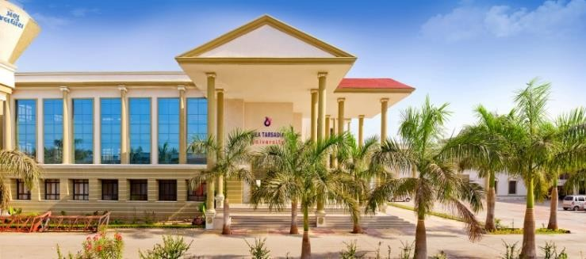
The Sponsor:
Gujarat State Biotechnology Mission
About the Training
The Crash Workshops are an intensive period of training with some of the best available resource persons delivering more than 60 formal lecture sessions with mock tests. Aspirants should be ready for an intensive period of learning. There are no fees for the crash workshops however, to ensure that the enrolled aspirants maintain an attendance of over 90%, a refundable deposit of Rs. 1,000 from each aspirant has been decided. For students the training will be for 15 days (8 hrs/day). Food, kits, books & accommodation will be provided free of cost at the institution
The success in ‘Transcripting Brighter Bio-Future’ from the neo tool-Biotechnology shall need world-class man-power and both the state and the central governments are working towards it. The Gujarat State Biotechnology Mission [GSBTM] formed under the aegis of Department of Science and Technology, Government of Gujarat; and operational with a few Sector Specialists headed by a Mission Director since April, 2004; is also taking some small but discrete steps towards development of an Institutional Network for Capacity Building Cells [N-BT- CBCs] in the field of Biotechnology. It is being envisaged that structured mentoring and provision of an institutional framework of Cells for Capacity Building shall help the budding biotechnologists to aim and hit high; at increasingly competitive examinations for professional careers in the field of Biotechnology.
Network of Biotechnology Capacity Building Cells of Gujarat State Biotechnology Mission
Sponsored
Fifteen Days Crash Workshop for Cracking IIT- JAM, GAT B and other national entrance exams from
December 10th to 24th 2024
Organized by
The Trainees
Students in the final year of graduation of any of the Biotech or allied subjects (like Microbiology, Biochemistry, Genetics, Bioinformatics, Environmental Sciences/technology, Molecular Biology, Human Genetics, etc.) can apply for crash workshop. The students in the prescribed number with a good representation from all of the other colleges in the nearby area will be selected and trained. Our center (NBT-CBC-UTU) has successfully conducted five batches since its inception in 2018. Many students who has undergone training from our centre have qualified in IIT-JAM, GAT-B, GATE and NET. Last year only, 10 students have qualified for IIT-JAM, TIFR and GAT-B.
Feedback of previous batch participants can be found at Link 1 https://www.youtube.com/watch?v=P_0rrYCSr_o
Link 2 https://www.youtube.com/watch?v=3foLwLdnBdQ
Link 3 https://www.youtube.com/watch?v=J4903haqRl8
The Organizer: Uka Tarsadia University (UGC approved & NAAC accredited)
The Twenty first century and globalization has created the need for evolution of newer centres of learning and higher education in the country. The establishment of Uka Tarsadia University in 2011 by the Bardoli Pradesh Kelavani Mandal with the help generous donation from philanthropic NRIs is an effort towards meeting the growing demand of quality education. The University offers admission in a comprehensive array of academic programs across various disciplines that lead students to self-enrichment and productive careers in their respective profession, government sector and Industry.
C. G. Bhakta Institute of Biotechnology Uka Tarsadia University
Maliba campus
Mahua Road, Tarsadi, Bardoli Dist. Surat – 394350, Gujarat
Committee
C G Bhakta Institute of Biotechnology
Chief-Patron
Dr D. R. Shah
CEO, Uka Tarsadia University
C. G. Bhakta Institute of Biotechnology (CGBIBT) is a constituent institute of Uka Tarsadia University. It was established in year 2005 for initiating exclusive education in Biotechnology and Applied Science. It offers 5 years M.Sc. Integrated programs, under graduate, post graduate programs, PGDMLT and doctoral research program in Biotechnology and Microbiology. Since Its establishment, CGBIBT has been striving to emerge as a centre of excellence in imparting career- based knowledge to the students to realize their professional ambition. Many research projects funded by central government agencies in the field of Biotechnology and Microbiology are being carried out. In addition, CGBIBT has also taken up a mission to support the local farming community to grow profitable crops by supplying quality planting materials to them from the sophisticated plant tissue culture lab and climate control green house established and accredited by DBT.
Patron
Dr Yogeshwar P Kosta
VC, Uka Tarsadia University
Chairman
Important dates Registration Date : 6th Dec 2024
Dr Meonis Pithawala
Director, C. G. Bhakta Institute of Biotechnology
: 10th to 24th 2024 Important Links
Coordinator
Session
Dr Gopal Jee Gopal
Assistant Professor, C. G. Bhakta Institute of Biotechnology
For registration: https://forms.gle/JdPKVVeEcJw2FTLn6
Organizing members
Dr Naga Rathna Supriya
Dr Dhruti Amin
Mr Rudrank Moharana
Dr N Ch Srivathsa Dr Ami Naik

Slide 2
APPLICATION FORM FOR TY BT CBC GSBTM CRASH WORKSHOP
2024 (Dec 10-24th)
(PLEASE FILL IT IN CAPITAL LETTERS)
NAME
CLASS (TY only)
SUBJECT MOBILE
E-MAIL ID
NAME OF THE COLLEGE COLLEGE ADDRESS
:………………………………………………………………………………….
: ………………………………………………………………………………...
:…………………………………………………………………………………
:…………………………………………………………………………………
:…………………………………………………………………………………
:…………………………………………………………………………………
:…………………………………………………………………………………
………………………………………………………………………………….
PHOTOGRAPH
UNDERTAKING:
I HEREBY AGREE AND COMMIT MYSELF FOR AT LEAST 90% ATTENDANCE (LECTURE & TEST) FAILING WHICH, THE DEPOSIT MONEY (RS.1000 (TY) WOULD NOT BE RETURNED TO ME.
SIGNATURE OF THE STUDENT:…………………………………………………..
RULES AND REGULATION FOR THE SELECTION OF STUDENTS:
The last date for the registration is 6th Dec 2024.
Selected students would be provided with intensive training from 8:30 AM to 5:30 PM from eminent teachers from various places. Food, kits, books & accommodation will be provided free of cost at the institution.
The selected Students are required to deposit Rs. 1000 for the registration and undertaking for more than 90% attendance, violating which the deposit money would be ceased. The money would be returned back after the successful completion of the workshop.
The final decision on any issue and change in the policy would be of GSBTM and the Coordinator of N-BT-CBC, CGBIBT, Bardoli.
If the student attends the entire program with 80-90 % attendance, the deposit money would be returned back on the last day after the valedictory function along with the certificate at the end of workshop.
C. G. Bhakta Institute of Biotechnology, Uka Tarsadia University, would be the center for this intensive crash workshop.
CO-ORDINATOR (NBT-CBC-UTU): Dr. Gopal Jee Gopal-9558880617; 8160245501, E-Mail: gopal.jee@utu.ac.in
WEBSITES www.btm.gujarat.gov.in (GSBTM), http://cgbibt.edu.in/nbtcbcutu.html (NBT-CBC-UTU unit)

